Slide 1
Abstract data types
Programming Language Design and Implementation
(4th Edition)
by T. Pratt and M. Zelkowitz
Prentice Hall, 2001
Section 6.2-6.3

Slide 2
Development of data types
1957-1960 FORTRAN, ALGOL - primitive data that mimics machine hardware
1960-1963 COBOL, PL/I - Extend primitive data with collections of primitive objects, records
1968-1970 Pascal, ALGOL-68 - Extends functionality with new types. Create functions that use those new types.
1972--1976 Age of encapsulation (Parnas)- Information hiding
Create data type signatures function prototype
Overloading
Inheritance
New languages:
Alphard (Wulf, Shaw, LondonU) Euclid (Toronto)
CLU (Liskov) Modula (Wirth)
Smalltalk (Kay) Ada (DoD)
Eiffel (Meyer)
1980--1985 Object Orientation - Smalltalk-80, C++, Miranda, ML, FORTRAN-90, Ada-95

Slide 3
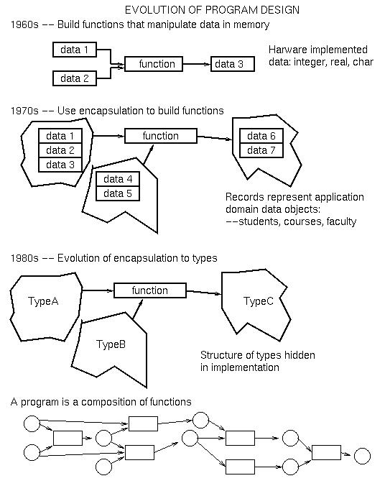

Slide 4
Types
A type (data type) is a set of values that an object can have.
An abstract data type (ADT) is a:
data type
Set of functions (operations) that operates on data of that type
Each function is defined by its signature.
Can also specify operations formally (Algebraic data types): f(g(A,S)) = A

Slide 5
Algebraic Data Types
Algebraic data type modeling
  A stack of integer
  push : stack x element → stack
  pop : stack → stack
  top : stack → integer U {undefined}
  empty : stack → Boolean
  size : stack → integer
  newstack : → stack

Slide 6
Algebraic Data Types (cont.)
Functions and constraints
  pop(push(S,I)) ➔ S
  pop(newstack) ➔ stack_empty_error
  top(push(S,I)) ➔ I
  top(newstack) ➔ stack_empty_error
  empty(newstack) ➔ true
  empty(push(newstack,I)) ➔ false
  size(newsatck) ➔ 0
  size(push(S,I)) ➔ size(S) + 1
만약 stack의 크기에 제한이 있다면
  size(S) is equal to limit_of_stack , push(S,I)
  ➔ stack_full_error

Slide 7
Example ADT
ADT student:
Operations:
SetName: name x student → student
GetName: student → name
SetCourse: course x student → student
GetCourse: student → course *
GetCredits: student → integer
In this example, Name and Course are undefined ADTs. They are defined by some other abstraction.
Information hiding: We have no idea HOW a student object is stored, nor do we care. All we care about is the behavior of the data according to the defined functions.

Slide 8
Information hiding
Information hiding can be built into any language
C example:
typedef struct {i:int; ... } TypeA;
typedef struct { ... } TypeB;
P1 (TypeA X, other data) { ... } - P1:other data → TypeA
P2 (TypeB U, TypeA V) { ... } - P2:TypeA → TypeB
Problems with this structure:
No enforcement of information hiding. In P2 can write V.i to access component i of of TypeA object instead of calling P1.
Success depends upon conventions
But advantage is that it can be done in Pascal or C.
We will look at mechanisms later to enforce information hiding (Smalltalk, C++, Java, Ada). We will call this enforcement encapsulation.

Slide 9
Implementation of subprogram storage
Before looking at ADTs in detail, we first need to understand the usual method for subprograms to create local objects.
Each subprogram has a block of storage containing such information, called an activation record.
Consider the following C subprogram:
float FN( float X, int Y)
const initval=2;
#define finalval 10
float M(10); int N;
N = initval;
if(N<finalval){ ... }
return (20 * X + M(N)); }
Information about procedure FN is contained in its activation record.

Slide 10
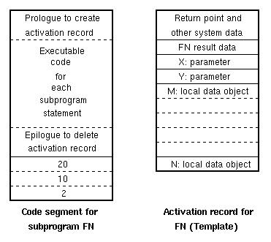
Activation records
Above left: Code produced by compiler for the execution of procedure FN.
Above right: Data storage needed by procedure FN during execution. Compiler binds each identifier in FN with a storage location in activation record.

Slide 11
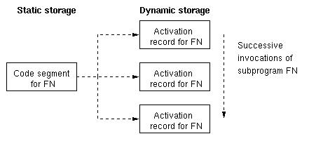
Dynamic nature of activation records
Each invocation of FN causes a new activation record to be created.
Thus the static code generated by the compiler for FN will be associated with a new activation record, each time FN is called.
As we will see later, a stack structure is used for activation record storage.

Slide 12
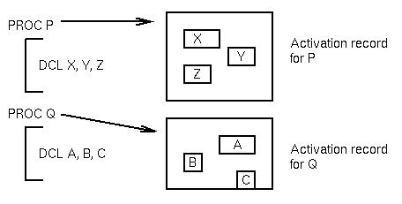
Storage management
Local data is stored in an area called an activation record (also called a stack frame).
Address data is a two step process:
1. Get a pointer to the relevant activation record containing the declarations.
2. Find the offset in that activation record for the data item.

Slide 13
Lifetime
IMPORTANT:
1. The activation record pointer is determined at during program execution. It occurs frequently, so it should be an efficient calculation.
2. The offset within an activation record is fixed and determined during compilation. It should require no - or minimal - calculations.
The lifetime of a variable is that period during program execution when the storage for the declared variable exists in some activation record (i.e., from the time the activation record for the declaring procedure is created until that activation record is destroyed).
The scope of a variable is the portion of the source program where the data item can be accessed (i.e., the name of the item is a legal reference at that point in the program).

Slide 14
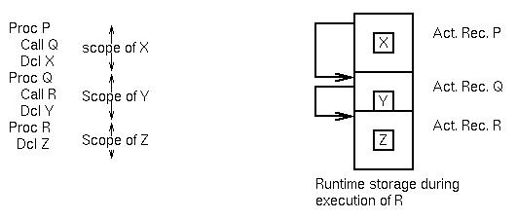
Lifetimes (continued)
Two models of data lifetimes:
Static: Based upon the static structure of a program
Dynamic: Based upon the execution of a program
In general, static lifetimes are implemented in stacks; dynamic lifetimes implemented in heaps.
⬅ 조심: static type과는 다르다!!!

Slide 15
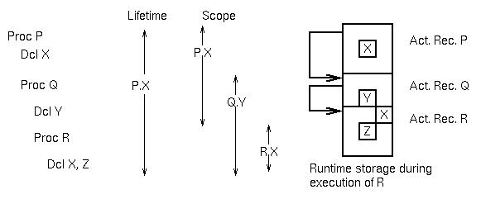
Lifetimes of variables
Lifetime of variable X is the period when the activation record for P exists.
Note that we can change the scope, but not the lifetime of a variable by nesting procedures:

Slide 16
Binding
Scope rule
  Lexical binding (deep binding)
    C, COMMON LISP
  Shallow binding (dynamic scope binding)
    LISP, SNOBOL4, APL, COMMON LISP
Binding time
  Runtime (dynamic) binding
  Compile time (static) binding

Slide 17
Example
main()
int a; ------------------------ ①
procedure first
int a; -------------------- ②
begin
call second;
end
procedure second
begin
a := 10; -------------- ③
end
begin
call first;
end
→ ③의 a는 ①의 a일까,②의 a일까? 만약 deep binding을 사용하면 ①의 a가 되며, shallow 바인딩을 사용한다면 ②의 a가 된다.

